Slide 1
HOUSE PRiCES CAPSTONE
By Kim Le

Slide 2

Objective
As an analyst at an investment bank, how should the business allocate dollars for investing in mortgage-backed securities?
Looked into multiple variables and analyzed sample data to see what determines the Sale Price of a house
Sample data is based on Kaggle House Prices
Notes:
Talk about the objectives of this analysis for Sale Prices
Securities - Financial instruments that hold value and can be traded between parties i.e. Bonds, Mutual Funds

Slide 3

Methods for Analysis
Distribution of the Data and the Variables
AA Test – Is sample data of Sale Price sufficiently biased?
Data Analysis Tool Pak
Correlation between Variables and Sale Price
Descriptive Statistics
Hypothesis Testing - Two-Sample Assuming Unequal Variances
Charts and Visualization
Notes:
Categorical Data, Numerical Data, Ordinal Data
Tool Pak – Correlation, Descriptive Statistics, Two-Sample t-tests

Slide 4

What Affects the Sale Price of a House?
I hypothesized the following factors would affect the Sale Price
Area (Square Foot) of the entire house and parts of the house i.e. Lot Area, House Area, Basement Area etc.
Overall Quality
Overall Condition
Year Built
Year Remodeled
Count of Rooms or Variables per House i.e Restroom, Total Rooms, Garage Space etc.
Type of House - MSSubClass
Notes:
Talk about categories of looking into factors of the House

Slide 5

AA Testing of Sale Price
Use this hypothesis test to prove test is sufficiently unbiased
Randomized sorting the sample to test two groups
Results on a 95% Confidence Interval
P-value = 0.3571
Failed to reject the null hypothesis (p > 0.05) so it eliminates the chance there is bias in the data
Notes:
Because the p-value > 0.05, we fail to reject to the null hypothesis as there is no significant difference between the specified sample population. The test shows the sample is sufficiently unbiased.

Slide 6
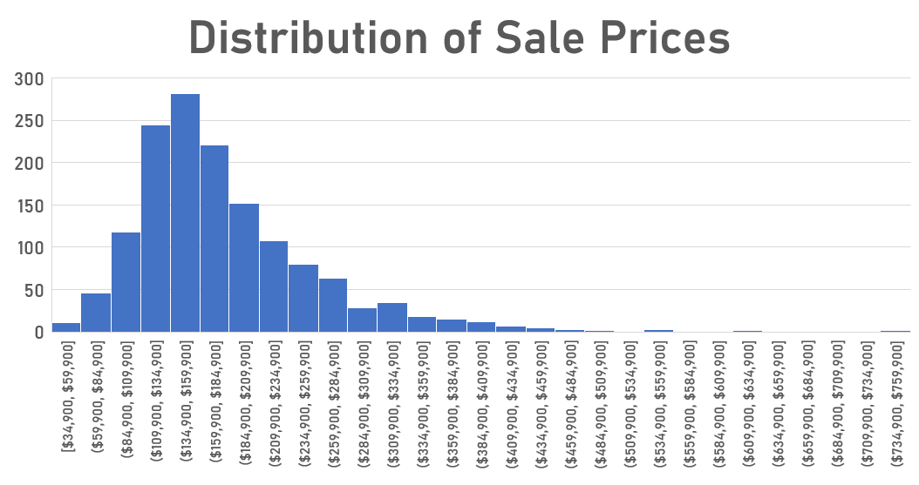

Slide 7
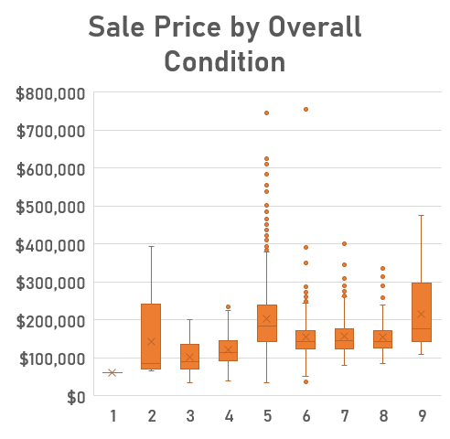
Results of Analysis
Variables with little impact on House Prices
Overall Condition
Bedroom Above Grade
Lot Area
Categorical Variables
MsSubClass – 1 story and 2 story built after 1946 had the highest averages for Sale Price
Notes:
Low Correlation (< .3)
Overall Condition - Rates the overall condition of the house

Slide 8
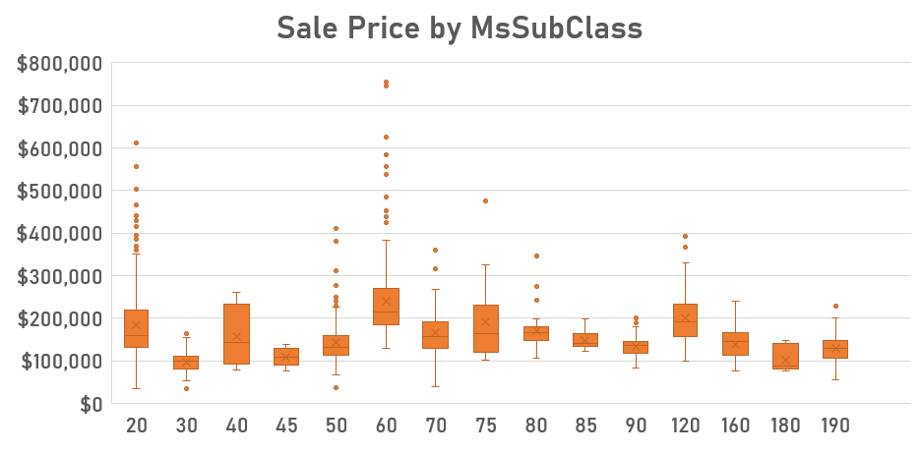
Notes:
Identifies the type of dwelling involved in the sale.
MSSubClass - 60, 2 -Story 1946 & Newer show the highest prices for the house type when determining the sale price of a house.
MSSubClass - 20, 1 -Story 1946 & Newer show second highest type of house having the highest sales prices when determining the sale price of a house. when determining the sale price of a house.
Based on the box and whisker plot, 1-story and 2 -story houses built after 1946 are more likely to sell for higher.

Slide 9
Results of Analysis (Cont.)
Variables with an impact on House Prices
Overall Quality
Total Floor Square Feet
Garage Space
Garage Area (Square Foot)
Total Bathrooms
Total Basement Area (Square Foot)
Year Built
Total Rooms Above Grade
Year Remodeled
Number of Fireplaces

Slide 10
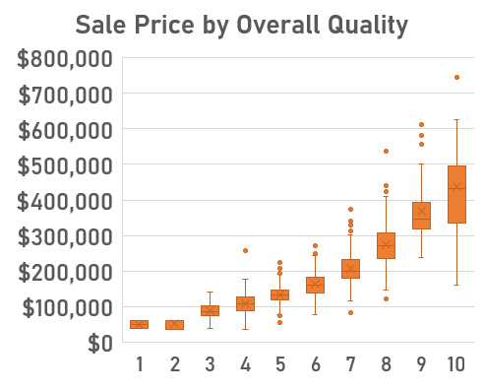
Overall Quality
Correlation – 0.79
T-tests
Ho: μ1 - μ2 = 0
Ha: μ1 - μ2 ≠ 0
Separated by two groups
Quality <= 5 and Quality >5
P-Value = 5.92 x 10^-145
P- Value < 0.05
Notes:
Reject the null hypothesis as there is no difference in population mean between Year Built and Overall Quality since the p-value is significant at the < .05 level. At the 95% Confidence level, the difference of means is between 76479 and 90464.
OverallQual: Rates the overall material and finish of the house

Slide 11
Total Square Foot
Correlation – 0.72
Trendline
Average – 1510 Square Foot
Median – 1458 Square Foot
Notes:
The correlation is .71 which shows there is a relationship between the Total Square Foot and the Sale Price. The higher the Total Square Foot, the higher the Sale Price is.
Total Square Foot – 1st floor + 2nd Floor

Slide 12
Year Built
Correlation – 0.52
T-tests
Ho: μ1 - μ2 = 0
Ha: μ1 - μ2 ≠ 0
Separated by two groups
Year <= 1973 and Year > 1973
P-Value = 1.08 x 10^-99
P-Value < 0.05
Notes:
Year Built – Year House has been built
Reject the null hypothesis as there is no difference in population mean between Year Built and Sale Price since the p-value is significant at the < .05 level. At the 95% Confidence level, the difference of means is between 76479 and 90464.

Slide 13

Summary
Look at the data and use various analysis tools to confirm which variables or factors increase Sale Prices
Use the recommended variables when investing in a mortgage-backed securities
Overall Quality, Total Floor Square Foot, Garage Space, Garage Area, Total Bathrooms, Bathroom Square Foot, Year Built, Total Rooms above Grade, Year Remodeled, Number of Fireplaces

Slide 14
Questions?

